Slide 1

ORC Turbomachinery –
from the cycle to the blade design
Fundamentals lecture + hands-on Python tutorial
+
Specific aspects of small-scale ORC turbines
First KCORC Summer School on innovative ORC and heat pump technologies
Jan Špale, PhD. | CTU in Prague | TUM Garching | 8 September 2026
Notes:
Open with the end-to-end challenge: cycle boundary conditions are easy; designing a fixed, supersonic, real-fluid turbine stage is not. The notebook and slides alternate throughout the session. [Sources] - KCORC_SummerSchool_updated.pdf — event title, scope and modeling-workshop context. - User brief — session date, duration and audience. - PhD_Thesis_JS_15122024_final.pdf — Chapter 4 design methodology. [/Sources]

Slide 2

TEACHING ROUTE
Understand the machine first, then we open Python… after coffee
01 Foundations
02 Short break
03 Engineering experiment
- turbine-cycle coupling
- Blade rows and velocity triangles
- Real-fluid nozzle physics
Close the lecture.
Open JupyterLab.
Work in pairs.
Predict a change.
Run a calculation.
Explain the result.
KCORC 2026 | CTU UCEEB

Slide 3
CYCLE AND MACHINE
The turbine is part of a closed thermodynamic loop
Heat in
TURBINE
High-pressure vapour
HEATER / EVAPORATOR
Generator
Low-pressure vapour
Not just an efficiency box
Its flow capacity, exit state and speed constraints feed back into the cycle.
P
CONDENSER
Liquid
Heat rejected
F03
Spale, PhD thesis (2024); original teaching diagrams
KCORC 2026 | CTU UCEEB
Notes:
Start from the familiar four-component ORC. The pump raises the pressure of a liquid; the turbine extracts shaft work from a vapour. Recuperation is intentionally omitted from the drawing. Point out that the turbine outlet state sets condenser duty and whether recuperation is possible. The pressure levels belong to a coupled network, not to an isolated prescribed turbine alone. Diagram is an original simplified teaching schematic. Suggested pace: ~2 min. [Sources] AUTHOR-SUPPLIED: Jan Spale, PhD thesis, PhD_Thesis_JS_15122024_final.pdf (2024), Chapters 2 and 4; use printed page numbers where specified. AUTHOR-SUPPLIED VISUAL ASSETS: UCEEB_prezentace_vzor_022026_CZ.pptx. Original UCEEB logos and cover background reused; Arial is the available sans-serif substitute for Technika. [/Sources]

Slide 4
CYCLE AND MACHINE
Cycle and turbine must be designed in both directions
CYCLE → TURBINE
TURBINE → CYCLE
Fluid and inlet total state
Outlet static pressure
Design mass flow
Heat source variability
Swallowing capacity
Efficiency and outlet enthalpy
Speed / torque operating range
Leakage, losses
F04
KCORC 2026 | CTU UCEEB
Notes:
Distinguish boundary conditions in a design exercise from unknowns in an operating cycle. With a fixed choked stator, the inlet thermodynamic state and throat area constrain mass flow. In sliding-pressure operation the cycle energy balance and turbine capacity jointly determine pressure and flow. A valve can separate evaporator pressure from turbine inlet pressure, but does not remove the turbine capacity equation. Inlet pressures and enthalpies for choking should be total quantities, or use negligible approach kinetic energy as an explicit assumption.

Slide 5
CYCLE AND MACHINE
… not all turbine powers are the same
Aerodynamic power
Shaft power
Net electrical power
Change in fluid
angular momentum
After the mechanical losses are included in the model
After generator, converter,
- At the el. outlet, after all aux. are considered
F05
KCORC 2026 | CTU UCEEB

Slide 6
ECONOMICS AND SCALE
Engineer‘s goal for an ORC turbine:
Optimise useful annual energy yield within an affordable machine
Peak isentropic efficiency
Few parts and repeatable manufacture
does not always make the best business case.
Reliable operation across variable heat source
Low leakage and manageable maintenance
what extra annual value pays for the extra aerodynamic complexity?...
F06
KCORC 2026 | CTU UCEEB
Notes:
Frame this as an engineering objective rather than a claim that efficiency does not matter in ORC. Heat-source intermittency, small product volumes, service costs and total installed cost can make a simpler stage commercially attractive. A two-stage or more elaborate design remains justified where its extra annual electricity and availability outweigh its added cost. For discussion, compare a slightly less efficient but robust machine with a narrow high-efficiency design that spends much of the year away from its optimum.

Slide 7
WHY ORC IS DIFFERENT
Molecular mass and complexity change the velocity scale
Molecular mass
Molecular complexity
Internal degrees of freedom
change heat capacities
and the ratio cp/cv.
Larger molar mass M means a smaller gas constant per unit mass.
Often smaller specific „head“ (enthalpy drop) and speed of sound.
F07
KCORC 2026 | CTU UCEEB
Notes:
Source-derived: the thesis section 2.3 discusses molar mass, molecular degrees of freedom and sound speed in a polytropic ideal-gas illustration. Qualification added for teaching: mass and complexity are related in many organic fluids but are not the same variable. The ideal-gas equations on this slide are intuition, not the real-fluid property model. At equal T0, pressure ratio and gamma, ideal-gas specific head scales with R_s and therefore with inverse molar mass. At changing gamma, inlet conditions or near saturation this is not a universal proportionality. Dense-vapour expansion must be evaluated with a real EOS.

Slide 8
WHY ORC IS DIFFERENT
Even a small enthalpy drop often leads to supersonic designs
Pressure ratio
Volume-flow ratio
Specific head
4.00
4.40
28.8 kJ/kg
p0 / p2
rho0 / rho2,is
h0 - h2,is
This is for HFO R-1233zdE… do you know typical steam turbine specific heads? And pressure ratios?
F08
KCORC 2026 | CTU UCEEB

Slide 9
WHY ORC IS DIFFERENT
ORC is not just a small steam turbine with a different fluid name
Shared physics
Mass, momentum and energy conservation; rotor Euler work; viscous losses.
Head per stage
Organic fluids often allow few stages the loading and speed limits still decide.
Expansion path
Steam may become wet. ORC fluids may be dry, wet or near-isentropic. Check the path! (although most are usually dry)
Thermodynamic model
Steam also needs real fluid properties. A constant gamma baseline is not universal…
F09
KCORC 2026 | CTU UCEEB
Notes:
Avoid treating all steam turbines as ideal-gas machines or all organic vapours as dry fluids. The relevant differences are fluid molecular properties, reduced inlet state, specific head, volume flow and scale. Water may require wet-steam treatment; some ORC expansions may approach or enter a two-phase region. Few stages are often attractive because of specific head and economics, but multistage ORC machines are also established. This slide qualifies broad statements rather than introducing a new universal categorisation.

Slide 10
ECONOMICS AND SCALE
Small-scale ORC is our focus today, but that is far from the whole ORC market
Main teaching focus: tens to hundreds of kW
1 kW
10 kW
100 kW
1 MW
10 MW
40 MW
Small products
Large installations
Tolerances, bearings, seals and conversion losses can dominate the engineering effort
Commercial ORC systems extend to tens of MW; axial multi-stage choices remain relevant – typically in geothermal/biomass
Positive-displacement expanders are another popular option at small power, especially sub 50 kW.
F10
KCORC 2026 | CTU UCEEB
Notes:
The axis is an illustrative scope map, not a histogram or a claim about sales distribution. The thesis concentrates on small-scale turboexpanders. A current manufacturer example, Turboden, states products up to 40 MWe per shaft; this corrects a possible impression that ORC machines stop at the MW scale. Do not infer all ORC turbines are high speed or single stage. The turbine-versus-positive-displacement decision also depends on volume flow, pressure ratio, fluid, operating hours and cost.

Slide 11
BLADE-ROW FUNDAMENTALS
Impulse or reaction- where is the static enthalpy drop?
Static pressure (schematic)
Impulse stage
Most expansion occurs in the stator; the rotor mainly turns the jet.
Reaction
Reaction stage
Impulse limit
Part of the static enthalpy drop occurs inside the rotor.
Stator
Rotor
F12
KCORC 2026 | CTU UCEEB
Notes:
The sketch shows idealised pressure distributions, not an exact measured expansion. At constant radius, rothalpy conservation gives h1+w1^2/2=h2+w2^2/2 for an adiabatic rotor. In an impulse rotor with approximately constant static pressure, loss-induced reduction of relative speed can correspond to a static enthalpy rise. It must not be interpreted as a useful positive rotor expansion. Reaction is defined using a static enthalpy drop with an explicitly stated denominator. This is an intentional clarification of a potentially confusing earlier discussion.

Slide 12
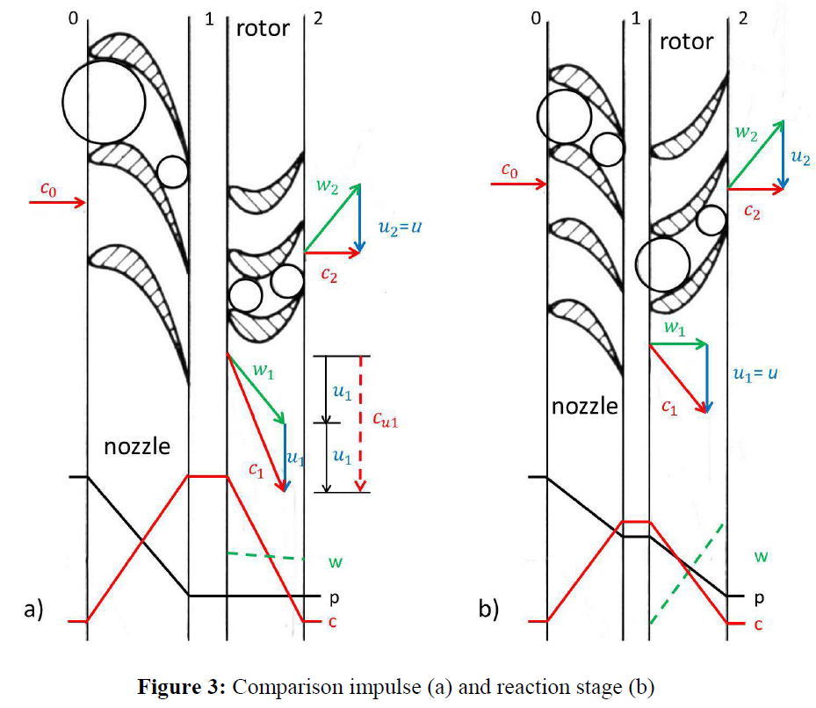
Impulse or reaction?

Slide 13
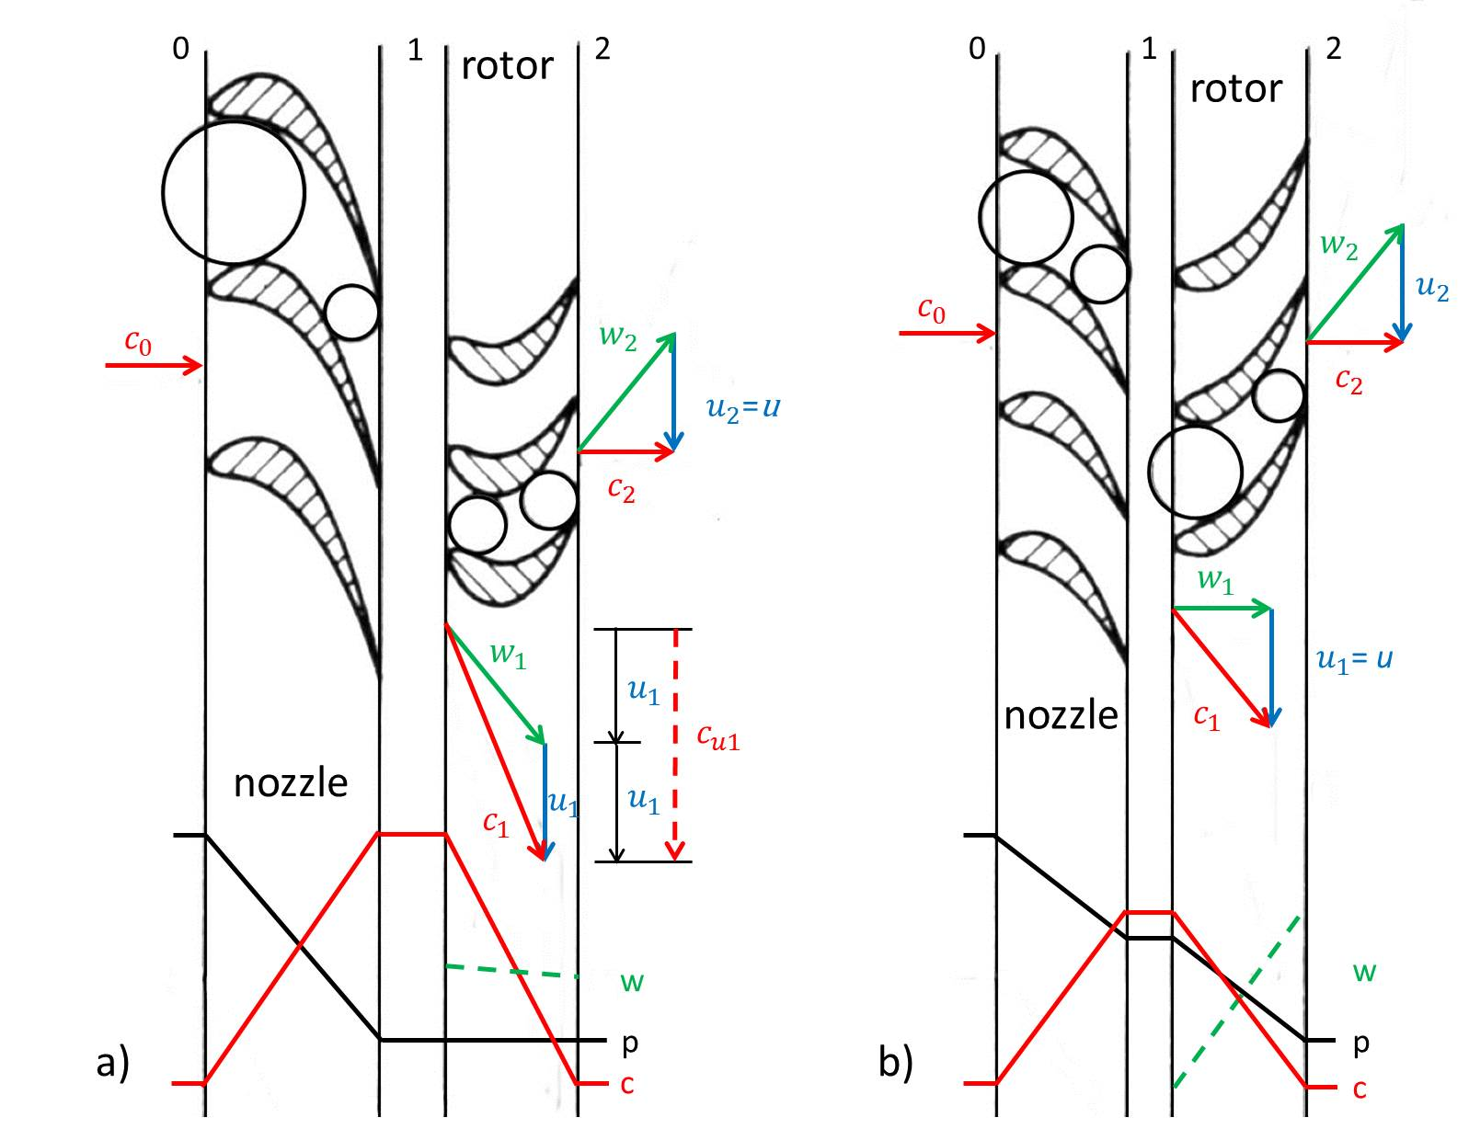


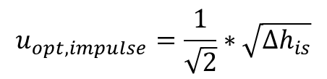
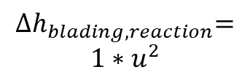


Why a simple axial impulse turbine for small scale? Impulse versus Reaction Stage
$∆h_{Blading }$= $c_{u1}$*$u_{1}$-$c_{u2}$*$u_{2}$
$$u_{opt,impulse}=\frac{1}{\sqrt{2}}∗\sqrt{∆h_{is}}$$
$$u_{opt,reaction}=1∗\sqrt{∆h_{is}}$$
u_{opt,impulse} = u_{opt,reaction} /$\sqrt{2}$
$${∆h}_{blading,impulse}=2∗u^{2}$$
$${∆h}_{blading,reaction}=$$
$$1∗u^{2}$$
Notes:
In principle, any axial or radial turbine can be implemented as impulse or reaction stage.
In the case on an I stage the entire stage enthalpy drop or pressure drop is converted into kinetic energy within the nozzle row. Therefore, very high (supersonic) velocties are achieved wich reduce efficiency. The pressure and velocity across the rotor remain constant. Thus, no axial thrust is generated, partial admission is an option for part load and facilitates the realization of smaller turbines. This is further supported by the fact that even rotor inlet is subjected to the minimal pressure an maximal volume flow which occur in the cycle which helps to keep the blade height above a critical value.
In a R stage the enthalpy drop is equally distributed between nozzle and rotor blades. Thus, velocities are smaller and hence efficiency higher. Because there is a pressure drop across the rotor it produces axial thrust and partial admission does not work properly. Rotor inlet Ma are limited below unity – let´s say 0.85. This fact limits the achievable VRAT or PR below about 10.
Applying the EULER equation on both stages we can see that the possible specific work done in an I stage is 2u2 and in an R stage only 1u2. That means for the same specific work done, the i stage requires a about 30% lower circumferntial or rotational speed tha the R-stage.

Slide 14
BLADE-ROW FUNDAMENTALS
Velocity triangles - a visual aid for a change of reference frame
STATOR EXIT / ROTOR INLET
ROTOR EXIT
w2
c2
c1
w1
U
U
Absolute nozzle Mach: 1.49
Relative rotor inlet Mach: 0.81
F15
KCORC 2026 | CTU UCEEB
Notes:
The vectors use the uploaded R1233zd(E) case at 10000 rpm, D=0.2 m and both metal-angle inputs 27 degrees. Axial velocities are approximately 44 and 40 m/s. U=104.72 m/s. Inlet relative speed is 119.61 m/s, whereas nozzle absolute speed is 220.39 m/s. Divide each by the same inlet-to-rotor sound speed, 147.93 m/s, to obtain the distinct Mach numbers. Ask students to point to the reference frame associated with each arrow. Diagram is geometrically scaled from data, but row positions are illustrative.

Slide 15
BLADE-ROW FUNDAMENTALS
The rotor extracts angular momentum
General turbine Euler work
Axial stage at one mean radius
What high c2u tells us
What c2u does not tell us
Residual swirl is part of the exit kinetic energy. A diffuser or a following row may recover some of it.
Zero swirl is not automatically the efficiency optimum when other losses also change.
F16
KCORC 2026 | CTU UCEEB
Notes:
At fixed blade speed and inlet tangential velocity, Euler work increases as c2u decreases, including to negative c2u. Thus zero swirl is not the mathematical upper bound of Euler work. Exit kinetic energy depends on c2a as well as c2u. When changing speed or outlet metal angle, relative speed, incidence, rotor losses and exit kinetic energy vary together. This clarifies the earlier beta2 sweep: the nearest-to-zero point need not actually have zero swirl, and a constrained optimum is not a global optimum. General radial-machine work uses U1 and U2 separately.

Slide 16
BLADE-ROW FUNDAMENTALS
Three ratios answer three different design questions
Blade-speed ratio
Flow coefficient
Loading coefficient
„How fast is the blade relative to the available head?“
„How much axial flow passes relative to blade speed?“
„How much work does each stage extract?“
F17
KCORC 2026 | CTU UCEEB
Notes:
Separate these quantities explicitly because the early notebook called U/c_is a stage-loading indicator. That informal wording should not replace the conventional loading coefficient. Define c_is from the chosen total-to-static isentropic drop. The number of stages depends on the head that can be extracted per stage at acceptable velocity triangles, stress, Mach and efficiency. Similarity based on these ratios is useful but incomplete: Reynolds number, geometry ratios and real-fluid thermodynamic state also matter.

Slide 17
BLADE-ROW FUNDAMENTALS
The metal stays fixed but the incoming flow angle moves
Inlet: incidence
Outlet: deviation
Changing rpm changes U.
That changes w1u and the inlet flow angle.
The blade leading edge does not rotate with it…
The real flow need not leave at the metal angle.
Our simplified model sets outlet deviation to zero, in reality over/underloading…
F18
KCORC 2026 | CTU UCEEB
Notes:
In the supplied model the rotor loss fit assumes matched flow and metal angles. Keep its geometric turning definition; do not quietly replace it with arbitrary off-design flow turning. The added sin-squared incidence penalty with K_i=1 is an illustrative uncalibrated teaching assumption, not a validated general turbine correlation. Zero outlet deviation is a second explicit simplification. Do not claim either approximation predicts stall, shocks or separation. Students should see the distinction between a model closure and a conservation law.

Slide 18
ECONOMICS AND SCALE
Small blade spans make ordinary tolerances expensive
h = 2 mm
h = 20 mm
High vapour density + small flow
→ small active flow area
gap / h = 1%
gap / h = 10%
Same illustrative tip gap: 0.20 mm
Watch the clearances, chord and aspect ratio and not just absolute millimetres
F19
KCORC 2026 | CTU UCEEB
Notes:
The two gap ratios are a purely geometric illustration, not predictions of 10% and 1% leakage loss. The two blade drawings are not at one geometric scale. A small inlet volume flow can create short axial blades, increasing relative tip clearance and endwall influence. Small turbines are not automatically low-Reynolds-number: high density can offset reduced chord. Evaluate Re=rho*w*c/mu and relative roughness. Manufacturing throat errors also alter swallowing capacity.

Slide 19
ECONOMICS AND SCALE
Partial admission trades more span for unsteady losses
Filling and emptying of rotor passages
Ventilation loss in inactive sectors
Full admission
Partial admission
Periodic forcing and blade fatigue
A full ring of rotor blades can still be partially admitted by the stator.
F20
KCORC 2026 | CTU UCEEB
Notes:
The admission fraction measures active circumferential extent, not the fraction of rotor blades manufactured. Explain the trade-off at fixed mass flow: less active arc demands more height if the other flow variables remain fixed. Real stage losses include sector entry/exit processes and windage, and blade loading becomes periodic. The existing research code contains approximate partial-admission closures; they should not be taught as universal laws. Full-admission geometry should be handled consistently when rounding blade/nozzle counts.

Slide 20
ECONOMICS AND SCALE
Smaller diameter can mean higher speed
D = 0.20 m
D = 0.05 m
10 000 rpm
95.5 Nm
40 000 rpm
23.9 Nm
The smaller rotor asks for a different bearing, rotordynamic and electrical solution
F21
Derived illustration at U = 104.7 m/s and shaft power = 100 kW
KCORC 2026 | CTU UCEEB
Notes:
This arithmetic illustration holds U and shaft power fixed and therefore is not a pair of optimised turbine designs. Four times smaller mean diameter implies four times higher rpm and one quarter of the torque. High speed is driven by matching blade-speed ratio at small diameter, not directly by a rule that every organic-fluid machine rotates quickly. Stress, critical speeds, thrust, balance quality, bearing losses and generator cooling must be checked independently. This is where an aerodynamic optimum encounters mechanical feasibility.

Slide 21
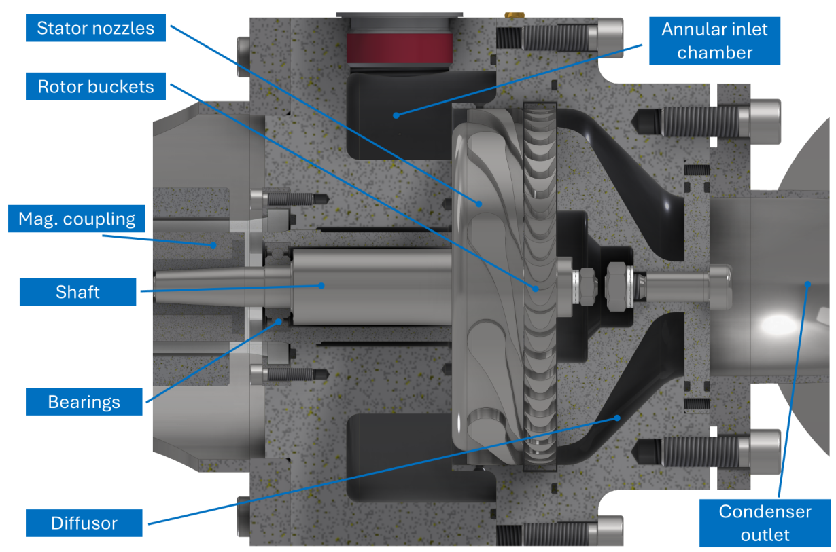
MECHANICAL INTEGRATION
Bearings and containment are part of the turbine design
Three bearing families
Rolling bearings: lubrication, life and fluid compatibility
Gas / working-fluid bearings: rotor dynamics and start-stop behaviour
Active magnetic bearings: controls and touchdown support
F23
KCORC 2026 | CTU UCEEB
Notes:
The image is a crop of the author-supplied thesis Figure 5.5, printed page 98, showing the Mark II assembly; no performance claims are inferred from the drawing. Do not confuse magnetic couplings with magnetic bearings. Literature examples show feasibility, not a universal preferred choice: Rosset et al. report an oil-free small ORC turbogenerator on gas-lubricated bearings, while Tanaka et al. describe a hermetic generator with magnetic bearings. Selection depends on loads, speed, fluid, temperature, start-stop duty and economics.

Slide 22
MECHANICAL INTEGRATION
High-speed generator AC is not grid-frequency AC
Turbine
PM generator
Rectifier
+ DC link
Inverter
Grid / load
1 pole pair at 40 000 rpm
→ 667 Hz electrical frequency
Alternative= gearbox → lower-speed generator
F24
KCORC 2026 | CTU UCEEB
Notes:
The frequency equation is a standard synchronous-machine kinematic relation. With two poles (one pole pair), 40000/60=666.7 Hz. Power electronics decouple variable generator frequency from the grid. Semiconductor switching frequency is a different engineering choice and should not be equated to shaft-frequency-derived AC. A gearbox avoids some high-speed generator requirements but adds components, lubrication and losses. The overall package must include electrical losses and cooling, not only turbine isentropic efficiency.

Slide 23
REAL-FLUID AERODYNAMICS
Z, gamma and Gamma
Compressibility factor
Departure from the ideal-gas p-rho-T relation.
Heat-capacity ratio
Caloric response; alone not enough to reconstruct real fluid aerodynamics
Fundamental derivative of Gas Dyn.
Sound-speed variation and nonlinear wave behaviour.
F26
KCORC 2026 | CTU UCEEB
Notes:
Use R_s for the specific gas constant to avoid confusing it with the universal molar constant. Z can be below or above one, depending on state; dense vapour should not be defined by Z<1 as a universal rule. For a calorically perfect ideal gas, Gamma=(gamma+1)/2>1. For a real fluid, gamma=c_p/c_v is not generally the isentropic exponent in a^2=gamma*p/rho. Each property answers a different question, and an accurate EOS derivative is needed.

Slide 24
REAL-FLUID AERODYNAMICS
Gamma tells us how sound speed changes on an isentrope
Gamma > 1
Density falls → sound speed falls
Classical wave family
0 < Gamma < 1
Density falls → sound speed rises
Non-ideal, still classical wave family
Gamma < 0
Unconventional shockwave structures
Non-classical / BZT regime
F27
KCORC 2026 | CTU UCEEB
Notes:
Derive the sign directly from the definition rather than asking students to memorise the table. During an ordinary stable single-phase isentropic expansion density decreases. Hence a increases if Gamma<1. The distinction between classical and non-classical wave dynamics is Gamma=0, not Gamma=1. For a lossy flow path, da also includes (partial a/partial s)_rho ds, so a measured sound-speed increase alone cannot uniquely diagnose Gamma. Gamma exactly equal to one gives a locally zero isentropic density derivative of a.

Slide 25
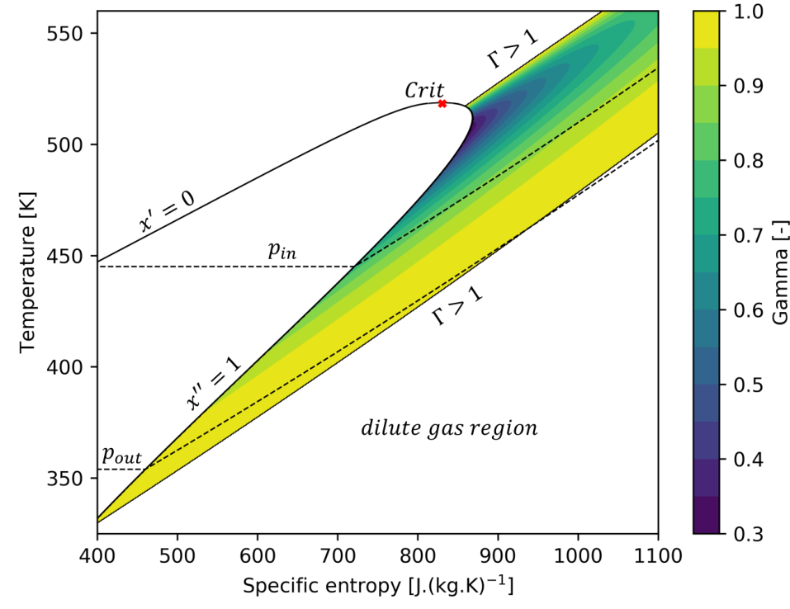
REAL-FLUID AERODYNAMICS
The state path matters as much as the fluid
Our R1233zd(E) isentrope
20 bar, 150 °C inlet
a = 128.4 m/s
a = 146.4 m/s
5 bar ideal outlet
14% net increase in sound speed.
Evaluate Gamma locally along the path.
MM: regions of Gamma < 1
F28
KCORC 2026 | CTU UCEEB
Notes:
The left-hand figure is reproduced from the author's thesis, Figure 2.8, showing MM and not R1233zd(E). Do not imply the pictured Gamma map belongs to the notebook fluid. The right-hand numbers are endpoints of the uploaded R1233zd(E) isentrope, with a 14.018% net increase. Only endpoint data are used here: they do not prove Gamma<1 everywhere along the interval. The notebook can evaluate Gamma locally. The figure is a property map, not a measured turbine performance map.

Slide 26
NOZZLE DESIGN
A convergent-divergent nozzle does two different jobs
Sonic throat
Throat area
Sets the choked flow capacity for a given inlet total state.
Divergent passage
Subsonic acceleration
Supersonic acceleration
Sets expansion and turning towards the target outlet flow.
F30
KCORC 2026 | CTU UCEEB
Notes:
The nozzle contour is an original qualitative sketch, not a manufacturing profile. In a standard steady adiabatic isentropic single-phase nozzle, dA/A=(Ma^2-1) dc/c. Geometry alone does not guarantee the flow regime: the inlet state and back pressure must support choking and the appropriate branch. Real-fluid sound speed and density enter the sonic state. Boundary layers, blockage, finite trailing-edge thickness and stator turning alter a practical passage. The meanline tool sizes areas; detailed geometry remains another level of modelling.

Slide 27
NOZZLE DESIGN
Use the real fluid isentrope to size and shape the passage
1
Inlet total state
2
Pressure sweep
3
Sonic state
4
Areas + contour
h0 and s0
h(p,s0), rho(p,s0), a(p,s0)
Find c(p*) = a(p*)
Capacity, expansion, turning
F31
KCORC 2026 | CTU UCEEB
Notes:
Keep h0 and s0 distinct from static properties. The first ordinary sonic point satisfies h0-h*=a*^2/2. The formula uses total active throat area, not full annulus area. For the actual outlet, use the selected loss model and matching density and velocity. Method of characteristics provides an inviscid contour in the supersonic region; a boundary-layer correction and CFD/experiment are separate. Uniform geometric scaling preserves area ratio. Stretching a contour to force a different outlet ratio is a new aerodynamic shape requiring verification, not a correction that preserves the original MOC solution.

Slide 28
NOZZLE DESIGN
The same nozzle cannot be perfectly adapted at every back pressure
Adapted
Underexpanded
Overexpanded
p_exit = p_back
p_exit > p_back
p_exit < p_back
F32
KCORC 2026 | CTU UCEEB
Notes:
The three sketches indicate wave tendencies downstream of a supersonic nozzle; they are not complete flow solutions. Overexpanded operation may develop shocks and separation, including inside the passage depending on back pressure. Choked capacity is independent of further downstream-pressure reduction only while the choked regime and inlet total state are maintained. There is no universal real-fluid critical ratio of 0.52-0.60. The current teaching off-design model monitors outlet-area mismatch, but does not resolve these wave structures. Therefore it should be presented as a reduced model, especially far from design.

Slide 29
MODEL CREDIBILITY
A great 1D meanline design may become into a terrible hardware
EOS
Meanline
MOC / 2D
CFD
Experiment
Check state and derivatives
Size and compare concepts
Shape supersonic passages
Resolve relevant flow losses
Test the complete hardware
It does not certify a nozzle, bearing system, rotor stress limit or guaranteed efficiency…
A model predicts useful trends.
F34
KCORC 2026 | CTU UCEEB
Notes:
The prototype discussion in the thesis explicitly identifies model limitations: radial variations, boundary layers, mechanical losses, diffuser uncertainty and manufacturing effects. An optimisation can exploit an empirical model outside its evidence base. A positive result with a small conservation residual only confirms internal consistency, not hardware accuracy. NICFD still needs reliable property measurements/EOS validation. This is the key bridge to a responsible hands-on tutorial: students should explain both the result and what the model does not contain.

Slide 30
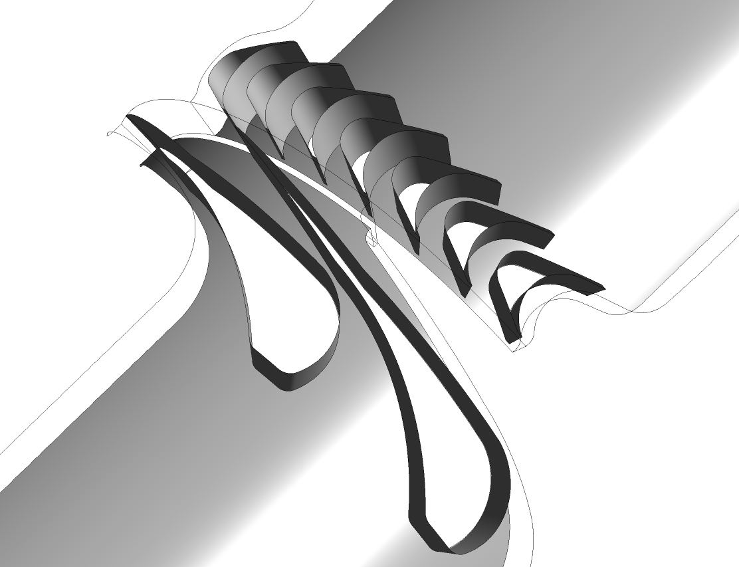
One way to reduce Design uncertainty: High fidelity CFD Numerical simulation
Geometry consists of two computational domains S and R
Domain S contains 2 stator blade channels (Laval nozzles)
The rotating domain R contains 7 intermediate blade channels.
Both domains have the same tangential pitch of 2π/5
Connected with frozen rotor interface
SST k-ω turbulence model
Pressure inlet BC with total p and total T given
Pressure outlet BC with static p given

Slide 31
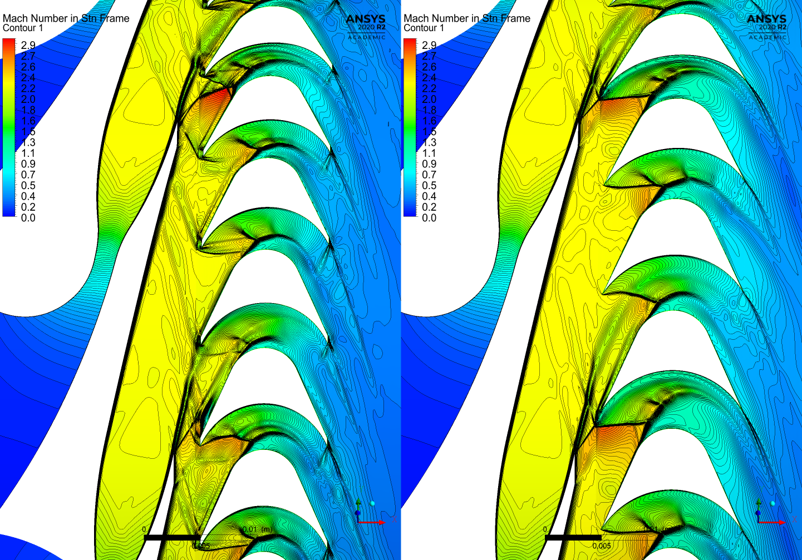
High fidelity CFD Numerical simulation

Slide 32
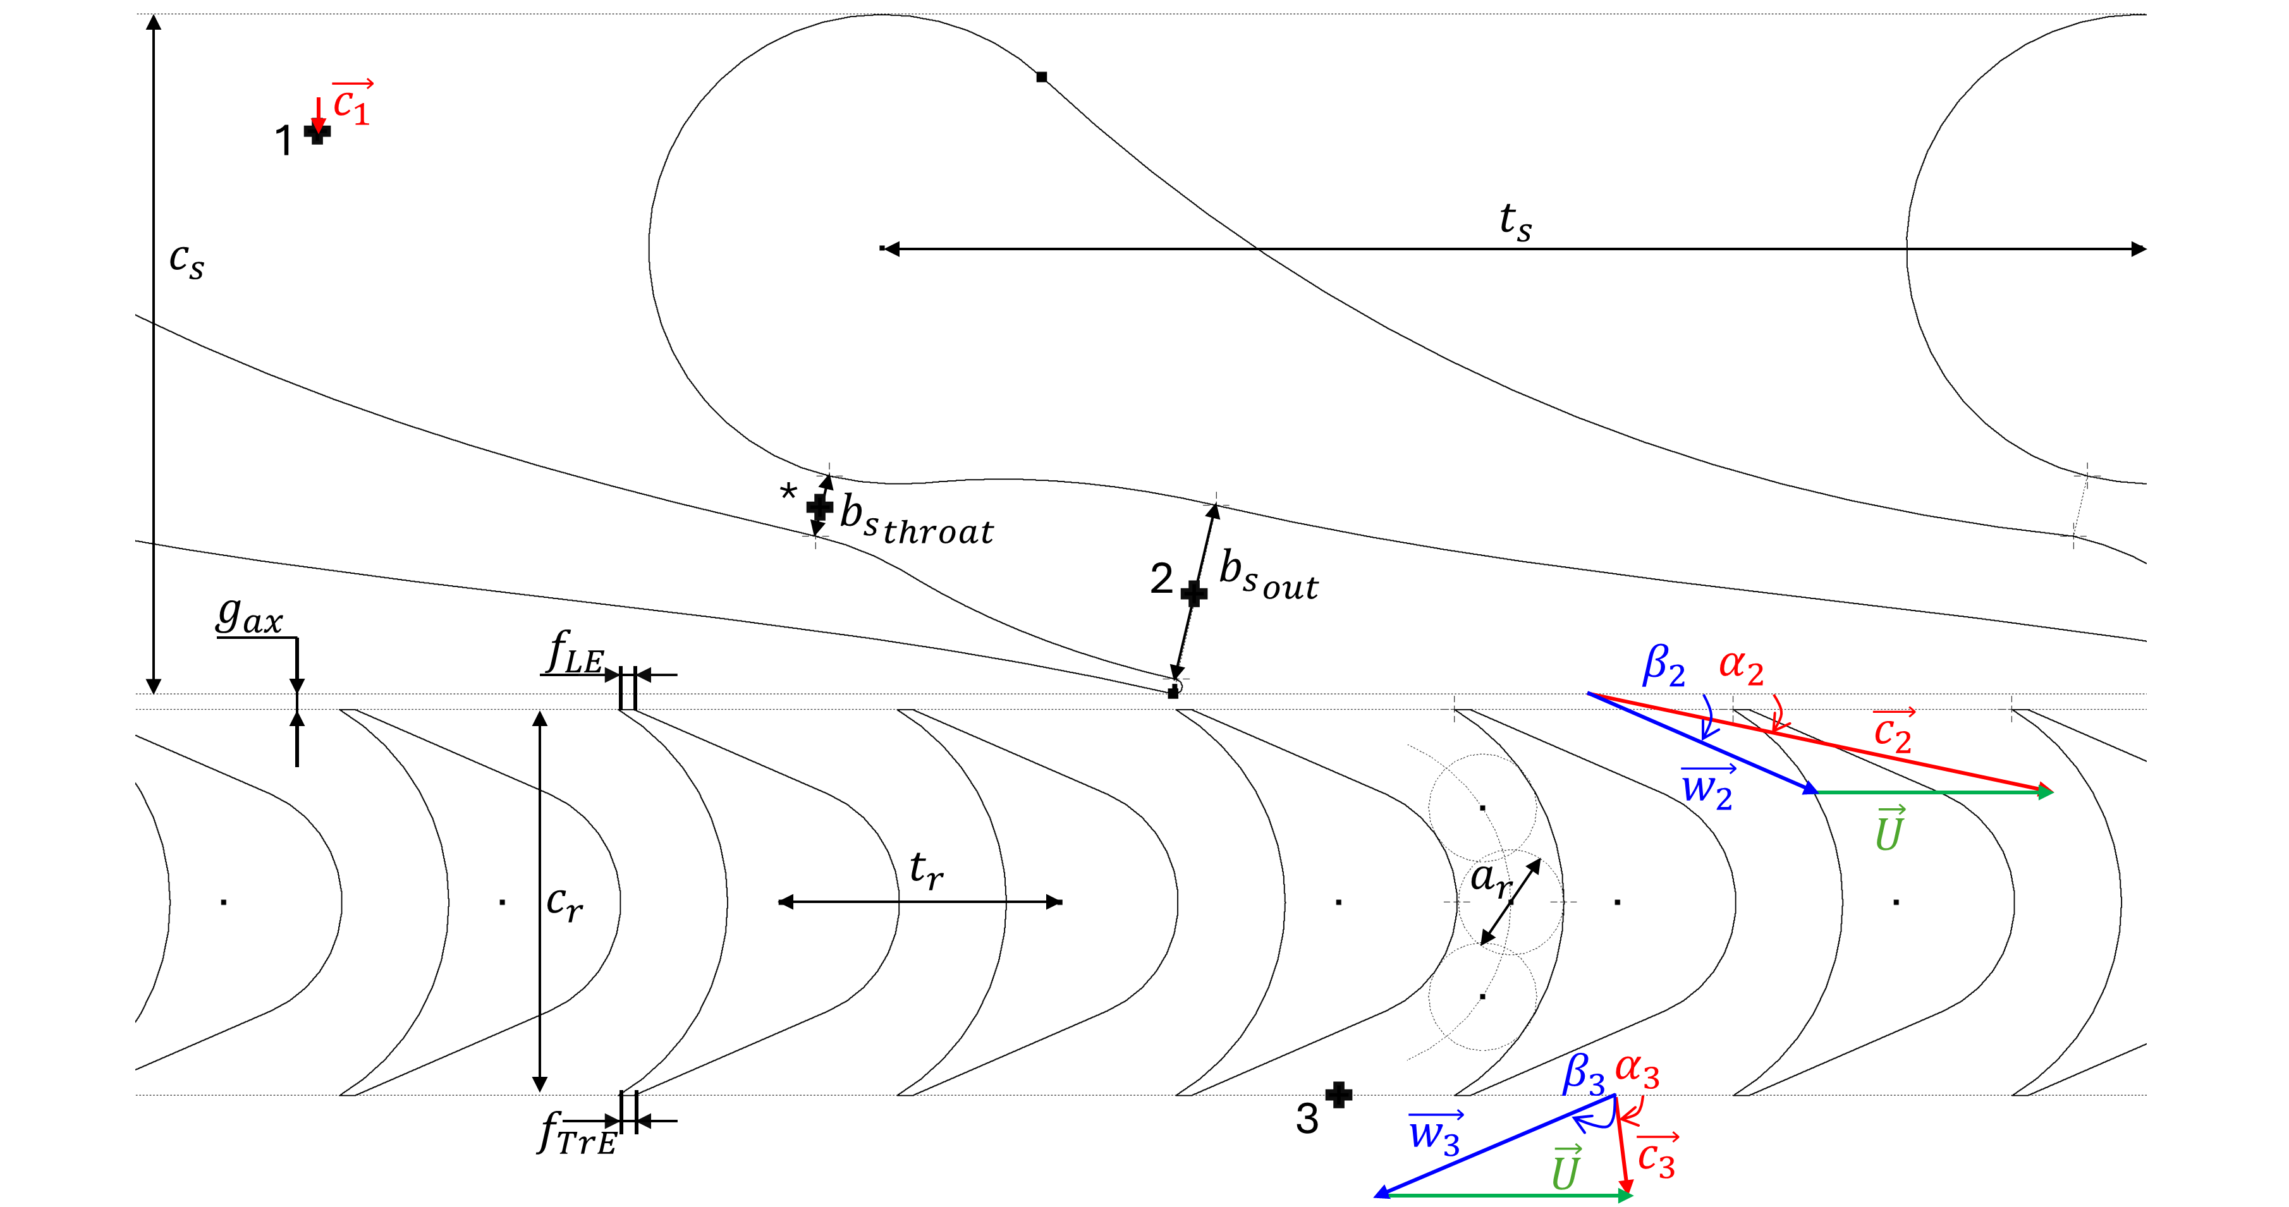
BLOCK D
Blade-to-blade plane design and notation
Notes:
Separate aerodynamic losses embedded in velocity coefficients from explicit mechanical/ventilation losses. The bar chart is a model bookkeeping aid, not a full exergy balance. [Sources] - design_point.json — power and loss values. - correlations.py — disk-friction and partial-admission loss models. - model.py — efficiency calculation. [/Sources]

Slide 33
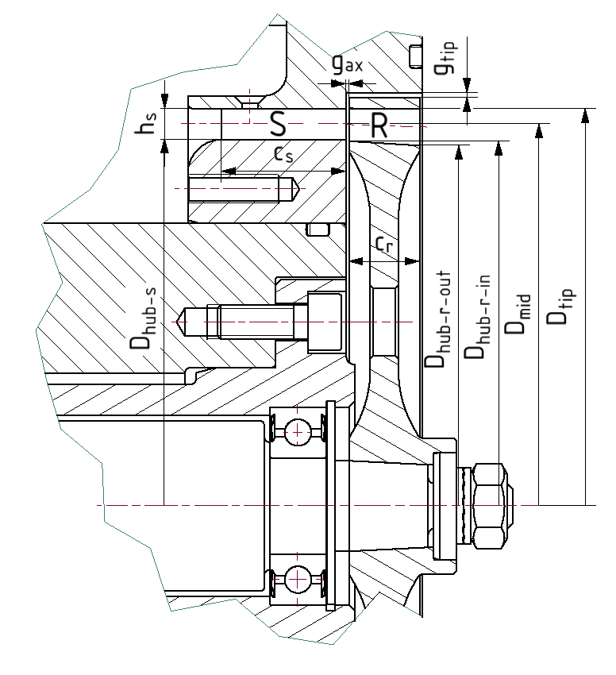
Meridional plane design and notation
BLOCK D
Notes:
Separate aerodynamic losses embedded in velocity coefficients from explicit mechanical/ventilation losses. The bar chart is a model bookkeeping aid, not a full exergy balance. [Sources] - design_point.json — power and loss values. - correlations.py — disk-friction and partial-admission loss models. - model.py — efficiency calculation. [/Sources]

Slide 34
BRIDGE TO TESPY
One turbine model and three things to pass to the cycle
Efficiency
A reduced curve along an assumed optimal-speed line.
Mass-flow capacity
Evaluate from the current turbine inlet total state.
Speed information
Report the associated rpm; do not solve it as a cycle input.
F37
KCORC 2026 | CTU UCEEB
Notes:
The reduced efficiency curve is calibrated along the selected fixed-outlet-pressure and inlet-superheat trajectory for one fluid and one frozen machine. Using it elsewhere is an approximation that must be stated, not made universal by normalisation. In TESPy the actual mass-flow residual should use the fixed throat and the current total inlet state, or negligible approach velocity. If a valve is introduced, use its downstream state. The root condition is h0-h*=a*^2/2 on s=s0, and the component residual is m_dot_TESPy-Cd*Astar*rhostar*astar=0. Check the valid choked operating region.

Slide 35

No Python installation or IDE setup is required.
ORC turbine design
Download KCORC_summer_school.zip
Extract KCORC_summer_school.zip
Double-click START_KCORC.bat
Wait until JupyterLab opens in your browser
Open: ORC_turbo_design/01_supersonic_orc_turbine_completed.ipynb
Run cells with Shift + Enter
Notes:
J01 - ORC turbine design: guided Jupyter workshop Suggested pace: 1 minute. This replaces the older notebook companion deck, not the foundations lecture. The class has already discussed turbomachinery physics before coffee. Use these slides as signposts, task prompts and joint checkpoints; spend most of the 100 minutes in the notebook. No previous Python experience is assumed. [Sources] Author-supplied guided student notebook (01_supersonic_orc_turbine_student_guided.ipynb), as provided in this conversation. Section headings and student variable names are retained; no notebook code is changed by this deck. Author-supplied ORC_Turbomachinery_Fundamentals_Addon_EN.pptx and UCEEB_prezentace_vzor_022026_CZ.pptx: reuse of UCEEB logo and cover background; same Arial typography, CTU blue, teal panels, margins and footer language. [/Sources]

Slide 36
START HERE
RUN IN NOTEBOOK
Open the guided notebook and run the first cells
IN THE FILE BROWSER
Before changing anything
01_supersonic_orc_turbine_
completed.ipynb
Run imports first.
Run the prepared input cell.
Confirm one working explorer.
default_inputs = DesignInputs(...)
design_explorer(default_inputs)
J04
KCORC 2026 | CTU UCEEB
Notes:
J04 - Open the guided notebook and run the first cells Suggested pace: 4 minutes. Open 01_supersonic_orc_turbine_student_guided.ipynb in the prepared Summer School JupyterLab environment. Run the imports, then the prepared DesignInputs cell, then design_explorer(default_inputs). This slide deliberately does not introduce a second environment-installation procedure. Important source-code behaviour: the widget calls replace(default, ...), so moving its sliders does not overwrite default_inputs, inputs or an already calculated reference_design. It is a preview. Later work uses the explicit baseline inputs cell. If startup fails, assist locally or let the pair share a machine; do not turn this into an installation workshop. [Sources] Author-supplied guided student notebook (01_supersonic_orc_turbine_student_guided.ipynb), as provided in this conversation. Section headings and student variable names are retained; no notebook code is changed by this deck. Author-supplied widgets.py and the later image-widget version discussed in the conversation. Author-supplied ORC_Turbomachinery_Fundamentals_Addon_EN.pptx and UCEEB_prezentace_vzor_022026_CZ.pptx: reuse of UCEEB logo and cover background; same Arial typography, CTU blue, teal panels, margins and footer language. [/Sources]

Slide 37
REFERENCE CASE
LOOK & PREDICT
Everyone starts from the same saved design point
Working fluid
Inlet
Outlet
R1233zd(E)
20 bar
5 bar
Pure fluid, real-property backend
150 °C
Static back pressure
Design mass flow
Rotor speed
Mean diameter
5.025
10 000
0.200
kg/s
rpm
m
J05
KCORC 2026 | CTU UCEEB
Notes:
J05 - Everyone starts from the same saved design point Suggested pace: 2 minutes. These are prescribed design inputs, not free off-design inputs. Describe p_in and T_in as inlet total quantities under the negligible approach-velocity convention in the notebook; p_out is static. Keep the baseline unchanged until after the equation exercises. Requested full admission is 1.0; the current source model rounds the nozzle count and stores an effective value 0.994718. Do not silently replace the model output with exact unity. [Sources] Author-supplied guided student notebook (01_supersonic_orc_turbine_student_guided.ipynb), as provided in this conversation. Section headings and student variable names are retained; no notebook code is changed by this deck. Author-supplied design_point.json: R1233zd(E), inlet 2 MPa / 423.15 K, outlet 0.5 MPa, 5.025 kg/s, 10000 rpm, mean diameter 0.2 m, inlet/outlet rotor metal-angle inputs 27 deg. Numbers are saved model outputs, not measured performance or a new solver run. Author-supplied ORC_Turbomachinery_Fundamentals_Addon_EN.pptx and UCEEB_prezentace_vzor_022026_CZ.pptx: reuse of UCEEB logo and cover background; same Arial typography, CTU blue, teal panels, margins and footer language. [/Sources]

Slide 38
EQUATION → PYTHON 1
TRY IN NOTEBOOK
A — Turn the cycle conditions into a velocity scale
Your five outputs
Pressure ratio
Isentropic head and velocity
Blade speed and U/c_is
J06
KCORC 2026 | CTU UCEEB
Notes:
J06 - A — Turn the cycle conditions into a velocity scale ACTIVITY 1 | 6 minutes. Notebook location: Block A - From cycle conditions to stage loading. Leave this slide projected while pairs work. Ask them to say what the equation means before editing. Only the marked np.nan expressions are editable. Do not ask them to write a function, loop or a property call. A syntax problem does not block the next section: the guided notebook uses the reference model downstream. Advance to the checkpoint only when discussing together. Suggested solution (not shown to participants yet): student_pressure_ratio = inputs.p_in_Pa / inputs.p_out_Pa student_dh_is_J_kg = state_in["h_J_kg"] - state_out_is["h_J_kg"] student_c_is_m_s = np.sqrt(2.0 * student_dh_is_J_kg) student_U_m_s = np.pi * inputs.D_mid_m * inputs.n_rpm / 60.0 student_U_over_cis = student_U_m_s / student_c_is_m_s Discussion prompt: What happens to U/c_is if n doubles while the inlet state, outlet pressure and diameter stay fixed? [Sources] Author-supplied guided student notebook (01_supersonic_orc_turbine_student_guided.ipynb), as provided in this conversation. Section headings and student variable names are retained; no notebook code is changed by this deck. Author-supplied design_point.json: R1233zd(E), inlet 2 MPa / 423.15 K, outlet 0.5 MPa, 5.025 kg/s, 10000 rpm, mean diameter 0.2 m, inlet/outlet rotor metal-angle inputs 27 deg. Numbers are saved model outputs, not measured performance or a new solver run. Author-supplied ORC_Turbomachinery_Fundamentals_Addon_EN.pptx and UCEEB_prezentace_vzor_022026_CZ.pptx: reuse of UCEEB logo and cover background; same Arial typography, CTU blue, teal panels, margins and footer language. [/Sources]

Slide 39
REFERENCE CHECKPOINT
CHECK TOGETHER
A — Check the scale before trusting the next calculation
Pressure ratio
Isentropic head
Isentropic velocity
4.00
28.83
240.1
p_in / p_out
kJ/kg
m/s
Blade speed
Blade-speed ratio
104.7
0.436
m/s
U/c_is
J07
KCORC 2026 | CTU UCEEB
Notes:
J07 - A — Check the scale before trusting the next calculation Suggested pace: 3 minutes after the activity. Expected values are pressure ratio 4; dh_is 28830.3958 J/kg; c_is 240.1266 m/s; U 104.7198 m/s; U/c_is 0.436102. If velocity is about 7.6 m/s, ask whether enthalpy was used in kJ/kg instead of J/kg. At fixed geometry and thermodynamic boundary conditions, doubling speed doubles U/c_is, not the imposed pressure ratio. Refer to this quantity as blade-speed ratio; the foundations deck distinguishes it from the conventional loading coefficient. [Sources] Author-supplied guided student notebook (01_supersonic_orc_turbine_student_guided.ipynb), as provided in this conversation. Section headings and student variable names are retained; no notebook code is changed by this deck. Author-supplied design_point.json: R1233zd(E), inlet 2 MPa / 423.15 K, outlet 0.5 MPa, 5.025 kg/s, 10000 rpm, mean diameter 0.2 m, inlet/outlet rotor metal-angle inputs 27 deg. Numbers are saved model outputs, not measured performance or a new solver run. Author-supplied ORC_Turbomachinery_Fundamentals_Addon_EN.pptx and UCEEB_prezentace_vzor_022026_CZ.pptx: reuse of UCEEB logo and cover background; same Arial typography, CTU blue, teal panels, margins and footer language. [/Sources]

Slide 40
EQUATION → PYTHON 2
TRY IN NOTEBOOK
B — Will the ideal nozzle outlet be supersonic?
Inlet enthalpy
Ideal outlet enthalpy
Outlet sound speed
504 812
475 982
146.39
J/kg
J/kg
m/s
J08
KCORC 2026 | CTU UCEEB
Notes:
J08 - B — Will the ideal nozzle outlet be supersonic? ACTIVITY 2 | 4 minutes. Notebook location: Block B - Supersonic stator and sonic throat. Leave this slide projected while pairs work. Ask them to say what the equation means before editing. Only the marked np.nan expressions are editable. Do not ask them to write a function, loop or a property call. A syntax problem does not block the next section: the guided notebook uses the reference model downstream. Advance to the checkpoint only when discussing together. Suggested solution (not shown to participants yet): student_c_exit_is_m_s = np.sqrt(2.0 * (h_in_J_kg - h_out_is_J_kg)) student_Ma_exit_is = student_c_exit_is_m_s / a_out_is_m_s Discussion prompt: Before calculating: compare the velocity scale from Block A with the real-fluid outlet sound speed. [Sources] Author-supplied guided student notebook (01_supersonic_orc_turbine_student_guided.ipynb), as provided in this conversation. Section headings and student variable names are retained; no notebook code is changed by this deck. Author-supplied design_point.json: R1233zd(E), inlet 2 MPa / 423.15 K, outlet 0.5 MPa, 5.025 kg/s, 10000 rpm, mean diameter 0.2 m, inlet/outlet rotor metal-angle inputs 27 deg. Numbers are saved model outputs, not measured performance or a new solver run. Author-supplied ORC_Turbomachinery_Fundamentals_Addon_EN.pptx and UCEEB_prezentace_vzor_022026_CZ.pptx: reuse of UCEEB logo and cover background; same Arial typography, CTU blue, teal panels, margins and footer language. [/Sources]

Slide 41
REFERENCE CHECKPOINT
CHECK TOGETHER
B — A sonic throat connects the inlet to a supersonic outlet
RUN THE PROVIDED PRESSURE-PATH CELL
Sonic pressure
1.248
MPa
Ma < 1
Ma = 1
Ideal outlet Mach
Ma > 1
1.640
-
The model finds the sonic state from the real fluid isentrope, not a fixed ideal-gas pressure ratio.
J09
KCORC 2026 | CTU UCEEB
Notes:
J09 - B — A sonic throat connects the inlet to a supersonic outlet Suggested pace: 3 minutes. Run the supplied path cell. The line art on this slide is schematic, not a MOC contour or a nozzle-coordinate export. The sonic pressure comes from the saved reference model: 1.247649 MPa. The reference design samples the first Ma>=1 point in its pressure grid; do not claim this is an exact root-finding solution. The student's two scalar equations confirm c_is=240.13 m/s and Ma_exit,is=1.6403. No student has to implement the pressure loop. [Sources] Author-supplied guided student notebook (01_supersonic_orc_turbine_student_guided.ipynb), as provided in this conversation. Section headings and student variable names are retained; no notebook code is changed by this deck. Author-supplied design_point.json: R1233zd(E), inlet 2 MPa / 423.15 K, outlet 0.5 MPa, 5.025 kg/s, 10000 rpm, mean diameter 0.2 m, inlet/outlet rotor metal-angle inputs 27 deg. Numbers are saved model outputs, not measured performance or a new solver run. Author-supplied ORC_Turbomachinery_Fundamentals_Addon_EN.pptx, relevant foundations slides; KCORC_2026_Supersonic_ORC_Turbine_Tutorial.pptx; supplied teaching source model.py, offdesign.py, correlations.py and incidence/NICFD additions discussed in the conversation. These are teaching-model assumptions, not independently validated universal correlations. Author-supplied ORC_Turbomachinery_Fundamentals_Addon_EN.pptx and UCEEB_prezentace_vzor_022026_CZ.pptx: reuse of UCEEB logo and cover background; same Arial typography, CTU blue, teal panels, margins and footer language. [/Sources]

Slide 42
BLOCK B
Quasi-1D nozzle path and choking
convergent
throat
divergent
12
KCORC Summer School 2026
Notes:
Walk through the pressure sweep: at each pressure, the static state comes from the inlet entropy, then enthalpy converts into kinetic energy. The first Ma≥1 point identifies the throat. [Sources] - model.py — _isentropic_path() and throat identification. - design_point.json — p_throat and Ma_out_is. [/Sources]

Slide 43
SUPPLIED LOSS MODEL
RUN ONLY
B — A real nozzle converts less of the head into jet speed
Nozzle coefficient
Loss-adjusted velocity
Loss-adjusted Mach
0.918
220.4
1.490
phi_s
m/s
-
The empirical coefficient is provided. There are many other options to account for losses
J11
KCORC 2026 | CTU UCEEB
Notes:
J11 - B — A real nozzle converts less of the head into jet speed Suggested pace: 2 minutes. Do not ask participants to reproduce polynomial coefficients. In the supplied model phi_s=0.917810, c1=220.3907 m/s and Ma1=1.489838. h1=480525.924 J/kg exceeds the isentropic outlet enthalpy. The actual outlet sound speed also changes, so Ma1 is not simply phi_s times the ideal Mach. Use the outlet formula shown; the path implementation has its own pedagogical loss distribution and is not re-derived here. [Sources] Author-supplied guided student notebook (01_supersonic_orc_turbine_student_guided.ipynb), as provided in this conversation. Section headings and student variable names are retained; no notebook code is changed by this deck. Author-supplied design_point.json: R1233zd(E), inlet 2 MPa / 423.15 K, outlet 0.5 MPa, 5.025 kg/s, 10000 rpm, mean diameter 0.2 m, inlet/outlet rotor metal-angle inputs 27 deg. Numbers are saved model outputs, not measured performance or a new solver run. Author-supplied ORC_Turbomachinery_Fundamentals_Addon_EN.pptx, relevant foundations slides; KCORC_2026_Supersonic_ORC_Turbine_Tutorial.pptx; supplied teaching source model.py, offdesign.py, correlations.py and incidence/NICFD additions discussed in the conversation. These are teaching-model assumptions, not independently validated universal correlations. Author-supplied ORC_Turbomachinery_Fundamentals_Addon_EN.pptx and UCEEB_prezentace_vzor_022026_CZ.pptx: reuse of UCEEB logo and cover background; same Arial typography, CTU blue, teal panels, margins and footer language. [/Sources]

Slide 44
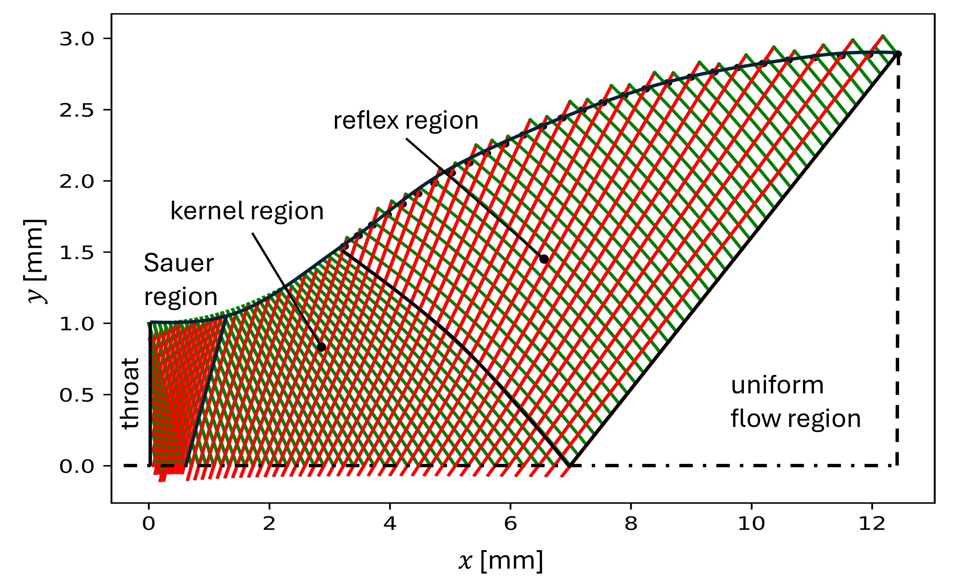
BLOCK B
Full nozzle geometric design – method of characteristics
12
KCORC Summer School 2026
Notes:
Walk through the pressure sweep: at each pressure, the static state comes from the inlet entropy, then enthalpy converts into kinetic energy. The first Ma≥1 point identifies the throat. [Sources] - model.py — _isentropic_path() and throat identification. - design_point.json — p_throat and Ma_out_is. [/Sources]

Slide 45
EQUATION → PYTHON 3
TRY IN NOTEBOOK
B — Use continuity twice to size the nozzle
At the throat
At the outlet
Use rho_star_kg_m3
and c_star_m_s.
Use the loss-adjusted
density and velocity.
Both areas are normal to the local flow. Calculate their ratio only after calculating each area.
J12
Notebook: Continuity and nozzle area | three EDIT HERE expressions
KCORC 2026 | CTU UCEEB
Notes:
J12 - B — Use continuity twice to size the nozzle ACTIVITY 3 | 5 minutes. Notebook location: Block B - Continuity and nozzle area. Leave this slide projected while pairs work. Ask them to say what the equation means before editing. Only the marked np.nan expressions are editable. Do not ask them to write a function, loop or a property call. A syntax problem does not block the next section: the guided notebook uses the reference model downstream. Advance to the checkpoint only when discussing together. Suggested solution (not shown to participants yet): student_A_throat_m2 = inputs.m_dot_kg_s / (rho_star_kg_m3 * c_star_m_s) student_A_outlet_m2 = inputs.m_dot_kg_s / (rho_nozzle_out_kg_m3 * c_nozzle_out_m_s) student_area_ratio = student_A_outlet_m2 / student_A_throat_m2 Discussion prompt: Which density and velocity belong to each section? Are these total areas for all nozzles, or one slot? [Sources] Author-supplied guided student notebook (01_supersonic_orc_turbine_student_guided.ipynb), as provided in this conversation. Section headings and student variable names are retained; no notebook code is changed by this deck. Author-supplied design_point.json: R1233zd(E), inlet 2 MPa / 423.15 K, outlet 0.5 MPa, 5.025 kg/s, 10000 rpm, mean diameter 0.2 m, inlet/outlet rotor metal-angle inputs 27 deg. Numbers are saved model outputs, not measured performance or a new solver run. Author-supplied ORC_Turbomachinery_Fundamentals_Addon_EN.pptx and UCEEB_prezentace_vzor_022026_CZ.pptx: reuse of UCEEB logo and cover background; same Arial typography, CTU blue, teal panels, margins and footer language. [/Sources]

Slide 46
JOINT INTERPRETATION
CHECK TOGETHER
B — Choose the velocity normal to the area you use
Flow-normal nozzle section
Axial annulus plane
The normal follows the jet.
Use c₁ = 220.4 m/s.
The normal follows the axis.
Use c₁a = 43.94 m/s.
Same continuity equation. Different surface orientation. No conflict between the two calculations.
J14
KCORC 2026 | CTU UCEEB
Notes:
J14 - B — Choose the velocity normal to the area you use Suggested pace: 3 minutes. This applies the control-surface distinction already introduced in the foundations lecture. No need for a new coding task. For a section normal to the local nozzle velocity use c1=220.3907 m/s. For the axial annulus plane use c1a=43.93884 m/s because alpha1=11.5 deg is measured from the tangential direction. Then A_axial=e*pi*D*h=A_normal/sin(alpha1); using either consistently yields the same mass flow. Blockage and nonuniformity are neglected in this first-order construction. [Sources] Author-supplied guided student notebook (01_supersonic_orc_turbine_student_guided.ipynb), as provided in this conversation. Section headings and student variable names are retained; no notebook code is changed by this deck. Author-supplied design_point.json: R1233zd(E), inlet 2 MPa / 423.15 K, outlet 0.5 MPa, 5.025 kg/s, 10000 rpm, mean diameter 0.2 m, inlet/outlet rotor metal-angle inputs 27 deg. Numbers are saved model outputs, not measured performance or a new solver run. Author-supplied ORC_Turbomachinery_Fundamentals_Addon_EN.pptx, relevant foundations slides; KCORC_2026_Supersonic_ORC_Turbine_Tutorial.pptx; supplied teaching source model.py, offdesign.py, correlations.py and incidence/NICFD additions discussed in the conversation. These are teaching-model assumptions, not independently validated universal correlations. Author-supplied ORC_Turbomachinery_Fundamentals_Addon_EN.pptx and UCEEB_prezentace_vzor_022026_CZ.pptx: reuse of UCEEB logo and cover background; same Arial typography, CTU blue, teal panels, margins and footer language. [/Sources]

Slide 47
EQUATION → PYTHON 4A
TRY IN NOTEBOOK
C — Step into the moving rotor frame
Angle hint
Use arctan2(axial, tangential),
then convert radians to degrees.
The first velocity line is done.
J15
KCORC 2026 | CTU UCEEB
Notes:
J15 - C — Step into the moving rotor frame ACTIVITY 4A | 7 minutes. Notebook location: Block C - Rotor velocity triangle, metal angle, and incidence. Leave this slide projected while pairs work. Ask them to say what the equation means before editing. Only the marked np.nan expressions are editable. Do not ask them to write a function, loop or a property call. A syntax problem does not block the next section: the guided notebook uses the reference model downstream. Advance to the checkpoint only when discussing together. Suggested solution (not shown to participants yet): student_w1a_m_s = c1a_m_s # already completed student_w1u_m_s = c1u_m_s - U_m_s student_w1_m_s = np.hypot(student_w1a_m_s, student_w1u_m_s) student_beta1_flow_deg = np.degrees(np.arctan2(student_w1a_m_s, student_w1u_m_s)) student_incidence_deg = student_beta1_flow_deg - inputs.beta_rotor_in_deg Discussion prompt: Does the blade metal angle change when speed changes? Which component is altered by subtracting U? [Sources] Author-supplied guided student notebook (01_supersonic_orc_turbine_student_guided.ipynb), as provided in this conversation. Section headings and student variable names are retained; no notebook code is changed by this deck. Author-supplied design_point.json: R1233zd(E), inlet 2 MPa / 423.15 K, outlet 0.5 MPa, 5.025 kg/s, 10000 rpm, mean diameter 0.2 m, inlet/outlet rotor metal-angle inputs 27 deg. Numbers are saved model outputs, not measured performance or a new solver run. Author-supplied ORC_Turbomachinery_Fundamentals_Addon_EN.pptx and UCEEB_prezentace_vzor_022026_CZ.pptx: reuse of UCEEB logo and cover background; same Arial typography, CTU blue, teal panels, margins and footer language. [/Sources]

Slide 48
SUPPLIED ROTOR MODEL
RUN ONLY
C — Keep the metal angle; account for incidence separately
Zero-incidence coefficient
Effective coefficient
Outlet assumption
0.777
0.771
Flow follows metal.
Deviation is neglected.
after the height correction
including inlet incidence
27° outlet-angle input = 153° direction from +u
J17
KCORC 2026 | CTU UCEEB
Notes:
J17 - C — Keep the metal angle; account for incidence separately Suggested pace: 3 minutes. The empirical matched-flow coefficient is evaluated using geometric turning. The teaching addition uses phi_eff^2=phi_0^2-K_i*sin(i)^2 with K_i=1. This is a transparent low-order assumption, not a validated universal incidence correlation. Do not present it as a result of the original design correlation. The saved height-corrected zero-incidence coefficient is 0.776973 and the effective coefficient is 0.771152. The outlet slider 27 deg denotes an acute angle from -u, so its direction measured from +u is 153 deg. Outlet deviation is neglected in this model. No student edits on this slide. [Sources] Author-supplied guided student notebook (01_supersonic_orc_turbine_student_guided.ipynb), as provided in this conversation. Section headings and student variable names are retained; no notebook code is changed by this deck. Author-supplied design_point.json: R1233zd(E), inlet 2 MPa / 423.15 K, outlet 0.5 MPa, 5.025 kg/s, 10000 rpm, mean diameter 0.2 m, inlet/outlet rotor metal-angle inputs 27 deg. Numbers are saved model outputs, not measured performance or a new solver run. Author-supplied ORC_Turbomachinery_Fundamentals_Addon_EN.pptx, relevant foundations slides; KCORC_2026_Supersonic_ORC_Turbine_Tutorial.pptx; supplied teaching source model.py, offdesign.py, correlations.py and incidence/NICFD additions discussed in the conversation. These are teaching-model assumptions, not independently validated universal correlations. Author-supplied ORC_Turbomachinery_Fundamentals_Addon_EN.pptx and UCEEB_prezentace_vzor_022026_CZ.pptx: reuse of UCEEB logo and cover background; same Arial typography, CTU blue, teal panels, margins and footer language. [/Sources]

Slide 49
EQUATION → PYTHON 4B
TRY IN NOTEBOOK
D — One line turns angular momentum into power
Mass flow
Blade speed
Tangential change
5.025
104.7
190.1
kg/s
m/s
m/s
J18
KCORC 2026 | CTU UCEEB
Notes:
J18 - D — One line turns angular momentum into power ACTIVITY 4B | 4 minutes. Notebook location: Block D - Euler work, losses, and turbine efficiency. Leave this slide projected while pairs work. Ask them to say what the equation means before editing. Only the marked np.nan expressions are editable. Do not ask them to write a function, loop or a property call. A syntax problem does not block the next section: the guided notebook uses the reference model downstream. Advance to the checkpoint only when discussing together. Suggested solution (not shown to participants yet): student_P_aero_W = inputs.m_dot_kg_s * U_m_s * (c1u_m_s - c2u_m_s) Discussion prompt: Should this turbine produce tens of watts, kilowatts, or megawatts? What sign should turbine power have? [Sources] Author-supplied guided student notebook (01_supersonic_orc_turbine_student_guided.ipynb), as provided in this conversation. Section headings and student variable names are retained; no notebook code is changed by this deck. Author-supplied design_point.json: R1233zd(E), inlet 2 MPa / 423.15 K, outlet 0.5 MPa, 5.025 kg/s, 10000 rpm, mean diameter 0.2 m, inlet/outlet rotor metal-angle inputs 27 deg. Numbers are saved model outputs, not measured performance or a new solver run. Author-supplied ORC_Turbomachinery_Fundamentals_Addon_EN.pptx and UCEEB_prezentace_vzor_022026_CZ.pptx: reuse of UCEEB logo and cover background; same Arial typography, CTU blue, teal panels, margins and footer language. [/Sources]

Slide 50
REFERENCE CHECKPOINT
CHECK TOGETHER
D — Separate aerodynamic, shaft and electrical power
Aerodynamic power
Mechanical power
Total-to-static efficiency
100.05
99.68
0.688
kW
kW
P_mech / (m_dot * dh_is)
Disk friction: 0.337 kW
Partial-admission term: 0.028 kW
J19
KCORC 2026 | CTU UCEEB
Notes:
J19 - D — Separate aerodynamic, shaft and electrical power Suggested pace: 4 minutes. The supplied model gives Paero=100047.235 W, disk friction=336.585 W, partial-admission loss=27.882 W, Pmech=99682.768 W and eta=0.688071. The small losses shown between Paero and Pmech do not mean the turbine is nearly 100 percent efficient: nozzle, rotor and residual-exit-velocity effects already enter Paero. Do not subtract aerodynamic losses again. Pmech is not a complete net electrical output. The input partial admission was 1.0 but the rounded source geometry gave 0.994718, explaining the nonzero small PA term. These values reproduce the source model, not a correction of it. [Sources] Author-supplied guided student notebook (01_supersonic_orc_turbine_student_guided.ipynb), as provided in this conversation. Section headings and student variable names are retained; no notebook code is changed by this deck. Author-supplied design_point.json: R1233zd(E), inlet 2 MPa / 423.15 K, outlet 0.5 MPa, 5.025 kg/s, 10000 rpm, mean diameter 0.2 m, inlet/outlet rotor metal-angle inputs 27 deg. Numbers are saved model outputs, not measured performance or a new solver run. Author-supplied ORC_Turbomachinery_Fundamentals_Addon_EN.pptx, relevant foundations slides; KCORC_2026_Supersonic_ORC_Turbine_Tutorial.pptx; supplied teaching source model.py, offdesign.py, correlations.py and incidence/NICFD additions discussed in the conversation. These are teaching-model assumptions, not independently validated universal correlations. Author-supplied ORC_Turbomachinery_Fundamentals_Addon_EN.pptx and UCEEB_prezentace_vzor_022026_CZ.pptx: reuse of UCEEB logo and cover background; same Arial typography, CTU blue, teal panels, margins and footer language. [/Sources]

Slide 51
GEOMETRY SUMMARY
LOOK & INTERPRET
D — Read the output as a first-order machine
RADIAL SPAN VS. DIAMETER
Mean diameter
200.0 mm
tip
Rotor hub / tip
191.7 / 208.3 mm
mean
h
Rotor height
8.25 mm
Stator / rotor count
24 / 25
hub
Effective admission
0.995
A meanline design gives flow states and first order dimensions
J20
KCORC 2026 | CTU UCEEB
Notes:
J20 - D — Read the output as a first-order machine Suggested pace: 3 minutes. The nozzle height is 7.954984 mm and rotor height 8.254984 mm. The added 0.3 mm is a model height allowance, not a specified tip clearance. Dhub=Dmid-h and Dtip=Dmid+h. There are 24 stator nozzles and 25 rotor blades in the saved case. Effective admission is 0.994718 after rounding. The unrolled meridional sketch is conceptual and not to scale; do not use it as a CAD section. Participants should compare the same values in reference_design.summary(). [Sources] Author-supplied guided student notebook (01_supersonic_orc_turbine_student_guided.ipynb), as provided in this conversation. Section headings and student variable names are retained; no notebook code is changed by this deck. Author-supplied design_point.json: R1233zd(E), inlet 2 MPa / 423.15 K, outlet 0.5 MPa, 5.025 kg/s, 10000 rpm, mean diameter 0.2 m, inlet/outlet rotor metal-angle inputs 27 deg. Numbers are saved model outputs, not measured performance or a new solver run. Author-supplied ORC_Turbomachinery_Fundamentals_Addon_EN.pptx and UCEEB_prezentace_vzor_022026_CZ.pptx: reuse of UCEEB logo and cover background; same Arial typography, CTU blue, teal panels, margins and footer language. [/Sources]

Slide 52
PAIRED ENGINEERING EXPERIMENT
TRY IN NOTEBOOK
Change one input; predict two consequences
01 Shaft speed
02 Inlet metal angle
03 Outlet metal angle
Change n.
Watch U/c_is and incidence.
What happens to power?
Change beta1.
Compare metal and flow.
Watch the rotor coefficient.
Change beta2.
Watch c2u and efficiency.
Does zero swirl appear?
Choose one case. Record the baseline. Make one change. Explain the trade-off.
J21
KCORC 2026 | CTU UCEEB
Notes:
J21 - Change one input; predict two consequences Suggested pace: 8-10 minutes. Each pair chooses just one case and records a baseline and a changed point. Speed case: change rpm, keep the other widgets fixed and watch blade-speed ratio, incidence, exit swirl and efficiency. Incidence case: change beta1 metal toward beta1 flow; explain that the design explorer also changes geometric turning when beta1 changes, so it is not a pure isolated incidence experiment. Outlet-angle case: change beta2, watch phi_r, c2u and power; positive residual swirl is not evidence by itself of an optimiser failure. The explorer calls design_stage, so geometry may be re-sized when a sizing-related input changes; this is a design comparison, not automatically off-design of the same hardware. [Sources] Author-supplied guided student notebook (01_supersonic_orc_turbine_student_guided.ipynb), as provided in this conversation. Section headings and student variable names are retained; no notebook code is changed by this deck. Author-supplied ORC_Turbomachinery_Fundamentals_Addon_EN.pptx, relevant foundations slides; KCORC_2026_Supersonic_ORC_Turbine_Tutorial.pptx; supplied teaching source model.py, offdesign.py, correlations.py and incidence/NICFD additions discussed in the conversation. These are teaching-model assumptions, not independently validated universal correlations. Author-supplied ORC_Turbomachinery_Fundamentals_Addon_EN.pptx and UCEEB_prezentace_vzor_022026_CZ.pptx: reuse of UCEEB logo and cover background; same Arial typography, CTU blue, teal panels, margins and footer language. [/Sources]

Slide 53
REDUCED OFF-DESIGN
RUN ONLY
E — Freeze the geometry before creating the handoff
Hardware stays fixed
Operating state can change
A*, A_out, diameter and height
Pitch, blade counts and metal angles
Inlet state and pressure ratio
Mass flow, flow angle and best speed
J23
KCORC 2026 | CTU UCEEB
Notes:
J23 - E — Freeze the geometry before creating the handoff Suggested pace: 2 minutes. Move from design_stage to freeze_geometry(reference_design). The fixed geometry includes diameters, areas, heights, pitch, nozzle/blade counts and metal angles. The evaluation sweeps inlet pressure at fixed outlet pressure, preserves design superheat where available, and tests speeds internally. The exported one-dimensional efficiency characteristic uses the best sampled speed at each pressure ratio. The speed is informative but the curve still assumes ideal variable-speed control. If a maximum occurs at the search boundary it is only the best tested speed, not a demonstrated global optimum. [Sources] Author-supplied guided student notebook (01_supersonic_orc_turbine_student_guided.ipynb), as provided in this conversation. Section headings and student variable names are retained; no notebook code is changed by this deck. Author-supplied turbine_reduced_characteristic.json, schema kcorc_reduced_turbine_characteristic_v1. Fixed outlet pressure 500000 Pa; inlet superheat preserved along the pressure sweep; efficiency-maximising speed selected internally; fixed choked throat with Cd=1. Author-supplied ORC_Turbomachinery_Fundamentals_Addon_EN.pptx, relevant foundations slides; KCORC_2026_Supersonic_ORC_Turbine_Tutorial.pptx; supplied teaching source model.py, offdesign.py, correlations.py and incidence/NICFD additions discussed in the conversation. These are teaching-model assumptions, not independently validated universal correlations. Author-supplied ORC_Turbomachinery_Fundamentals_Addon_EN.pptx and UCEEB_prezentace_vzor_022026_CZ.pptx: reuse of UCEEB logo and cover background; same Arial typography, CTU blue, teal panels, margins and footer language. [/Sources]

Slide 54
REDUCED CHARACTERISTIC
LOOK & INTERPRET
E — Give TESPy one efficiency curve
Efficiency [-]
design
0.75
One cycle input
0.73
Interpolate eta(PR).
Optimal rpm is reported,
not prescribed as a
second map coordinate.
0.71
0.69
0.67
2
3
4
5
6
Pressure ratio [-]
The curve assumes ideal variable speed operation along one specified thermodynamic path.
J24
KCORC 2026 | CTU UCEEB
Notes:
J24 - E — Give TESPy one efficiency curve Suggested pace: 3 minutes. Curve points are redrawn from the supplied JSON, not re-simulated. Thirty samples span PR=1.8 to 6.1032258. The ideal variable-speed speed sweep is internal, so shaft rpm is not a second independent axis in the handoff. The saved reference design at PR=4 and 10000 rpm has eta=0.688071; the optimal-speed curve is about 0.6909 at PR=4, so it need not pass through that efficiency value. Do not imply global validation from smoothness. In the previous diagnostics, the stator correlation and neglected off-design matching physics affected this decreasing trend. The 1D reduction belongs to the saved inlet-state path and fluid, not every ORC with the same pressure ratio. [Sources] Author-supplied turbine_reduced_characteristic.json, schema kcorc_reduced_turbine_characteristic_v1. Fixed outlet pressure 500000 Pa; inlet superheat preserved along the pressure sweep; efficiency-maximising speed selected internally; fixed choked throat with Cd=1. Author-supplied design_point.json: R1233zd(E), inlet 2 MPa / 423.15 K, outlet 0.5 MPa, 5.025 kg/s, 10000 rpm, mean diameter 0.2 m, inlet/outlet rotor metal-angle inputs 27 deg. Numbers are saved model outputs, not measured performance or a new solver run. Author-supplied guided student notebook (01_supersonic_orc_turbine_student_guided.ipynb), as provided in this conversation. Section headings and student variable names are retained; no notebook code is changed by this deck. Author-supplied ORC_Turbomachinery_Fundamentals_Addon_EN.pptx and UCEEB_prezentace_vzor_022026_CZ.pptx: reuse of UCEEB logo and cover background; same Arial typography, CTU blue, teal panels, margins and footer language. [/Sources]

Slide 55
TURBINE SWALLOWING CAPACITY
LOOK & INTERPRET
E — Choked does not mean constant mass flow
Mass flow [kg/s]
design
8
6
4
TESPy must use
2
The current inlet state
and the fixed total
throat area.
0
10
15
20
25
30
Turbine inlet pressure [bar]
J25
KCORC 2026 | CTU UCEEB
Notes:
J25 - E — Choked does not mean constant mass flow Suggested pace: 3 minutes. This plot uses inlet pressure, not pressure ratio, on the horizontal axis. All plotted points belong to the supplied sliding-pressure path with fixed outlet pressure and changing inlet temperature. Choking removes sensitivity to a further downstream-pressure reduction at a fixed inlet total state; it does not remove inlet-state sensitivity. m_dot=Cd*A_star*rho_star*a_star. For the TESPy residual, the sonic state must be evaluated from the current turbine inlet state; after an inlet control valve use the post-valve inlet. The JSON mass-flow array is a reference path, not a universal m_dot(PR) law. Outside the choked regime a separate model is needed. [Sources] Author-supplied turbine_reduced_characteristic.json, schema kcorc_reduced_turbine_characteristic_v1. Fixed outlet pressure 500000 Pa; inlet superheat preserved along the pressure sweep; efficiency-maximising speed selected internally; fixed choked throat with Cd=1. Author-supplied guided student notebook (01_supersonic_orc_turbine_student_guided.ipynb), as provided in this conversation. Section headings and student variable names are retained; no notebook code is changed by this deck. Author-supplied correspondence with Francesco Witte and the agreed sonic-throat residual pseudocode. Author-supplied ORC_Turbomachinery_Fundamentals_Addon_EN.pptx and UCEEB_prezentace_vzor_022026_CZ.pptx: reuse of UCEEB logo and cover background; same Arial typography, CTU blue, teal panels, margins and footer language. [/Sources]

Slide 56
EXPORT AND HANDOFF
RUN IN NOTEBOOK
E —JSON connects the two workshops
"fluid": "R1233zd(E)"
"fixed_geometry": { "A_throat_m2": ... }
"mass_flow_model": {
"discharge_coefficient": 1.0
}
"characteristic": {
"pressure_ratio": [...],
"eta_is_ts": [...],
"n_opt_rpm": [...]
}
Today
Run the export cell.
Tomorrow
Use the file in
Francesco’s TESPY model.
Save outputs/turbine_reduced_characteristic.json. The turbine and cycle remain separate models.
J26
KCORC 2026 | CTU UCEEB
Notes:
J26 - E — One JSON connects the two workshops Suggested pace: 2 minutes. Run the export cell. The code block here is a schema illustration, not literal runnable JSON. Keep the filename turbine_reduced_characteristic.json. In the supplied schema the total throat area is in fixed_geometry and Cd is in mass_flow_model; the same data need not be duplicated. Wednesday's model should interpolate efficiency, evaluate the inlet-state-dependent choked mass-flow residual and report rpm for information. P_mech and tabulated mass flow are reference-path outputs and should not be treated as universal cycle outputs. Do not ask students to implement TESPy UDEs during Tuesday's session. [Sources] Author-supplied guided student notebook (01_supersonic_orc_turbine_student_guided.ipynb), as provided in this conversation. Section headings and student variable names are retained; no notebook code is changed by this deck. Author-supplied turbine_reduced_characteristic.json, schema kcorc_reduced_turbine_characteristic_v1. Fixed outlet pressure 500000 Pa; inlet superheat preserved along the pressure sweep; efficiency-maximising speed selected internally; fixed choked throat with Cd=1. Author-supplied spale2026_turbine_tespy.py and correspondence with Francesco Witte: separation of efficiency and mass-flow constraints. Author-supplied ORC_Turbomachinery_Fundamentals_Addon_EN.pptx and UCEEB_prezentace_vzor_022026_CZ.pptx: reuse of UCEEB logo and cover background; same Arial typography, CTU blue, teal panels, margins and footer language. [/Sources]

Slide 57
Thank you!
Jan Špale, Ph.D.
jan.spale@cvut.cz
www.uceeb.cz
Notes:
End the lecture portion here. Keep the final slide visible during questions and the transition back to JupyterLab. [Sources] - UCEEB_prezentace_vzor_022026_CZ.pptx — visual template and closing-slide style. [/Sources]

